Slide 1
Publishing Spreadsheets with Excel Services
Running Excel spreadsheets on the server

Slide 2
Agenda
Excel Services Architecture
Configuring Trusted Locations
Publishing spreadsheets that render as HTML
Using Data Connections

Slide 3
Why Do We Need Excel Services?
Common customer requirements/complains
Distributing spreadsheets to users creates many copies
Excel doesn’t play well in the BI dashboard and reporting world
It’s difficult to protect proprietary information in spreadsheets
Incorporating Excel logic into applications is hard
Excel was designed as a desktop application (read: Excel really stinks as a server-side application)
Notes:
Instructor Notes
Try to interact with the audience here and ask questions that relate to the needs and challenges discussed on the slide.
What are you doing with Excel?
How do you collaborate on a spreadsheet (e.g. Some sales data) in your company?
Do you leverage the charting and calculation features of Excel?
Do you distribute Excel spreadsheets to your customers as part of your solution?

Slide 4

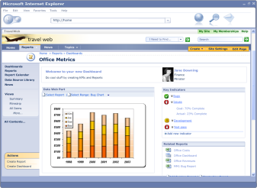



Excel Services
Browser
Excel 2007
Design and author
Calculated data and charts
Spreadsheets
Spreadsheets/snapshots
Spreadsheets/ Calculated data
Excel 2007
Office SharePoint Server & Excel Services
Custom Applications
Notes:
Instructor Notes
Overview of what Excel Services is all about:
Somebody creates an Excel spreadsheet
Publishes it to a SharePoint server where Excel Services is activated (point that Excel Services is a service provided by the Shared Service Provider)
Users can get a thin client view of the spreadsheet in their browser with the possibility of doing limited interaction with the spreadsheets
Via Web parts we can take snapshots (e.g a chart or a set of data) and use it somewhere else
A Web service can be consumed remotely by custom applications – these can interact (sending data, letting excel calculate, and getting results) with the spreadsheet in a programmatic way

Slide 5
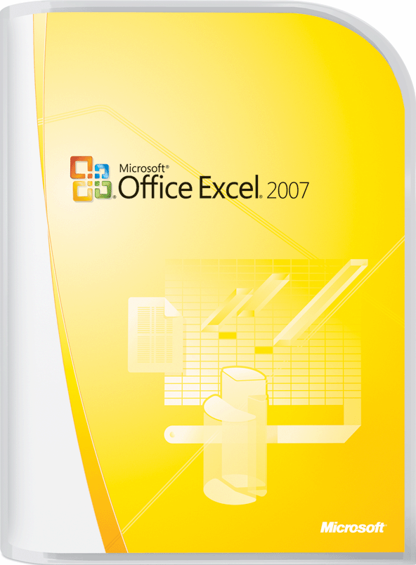
Excel 2007
Notes:
Instructor Notes:
Talk about new features of Excel 2007 and the ability to use the compatibility pack to create the .xlsx format with Excel 2003

Slide 6
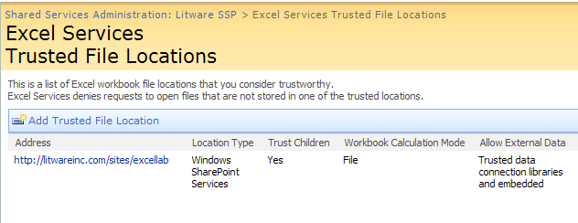
Configuring Trusted Locations

Slide 7
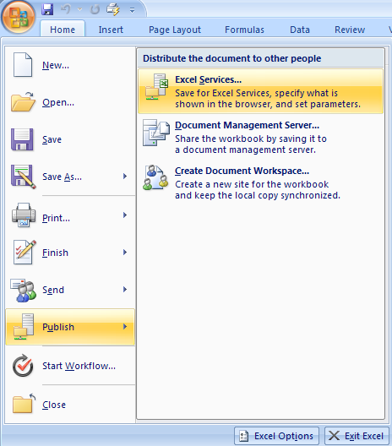
Walk Through of using Excel Services
Add the URL of the document library as trusted location
SharePoint Central Administration
In Application Management, configure the Farm’s core services
In Excel Services Management, add the URL of the doc lib as a trusted file location
In Excel 2007, publish to Office Server
Decide what worksheets to publish
Named ranges can be dynamically populated with values in the browser
Give the URL of a document library
Users now have Web access to the spreadsheet
Notes:
Instructor Notes
Here are the steps to enable a spreadsheet for Web Access
Before talking about the steps that need to be done in Excel itself, talk about step 2 where an administrator has to add the URL to the doc lib (or possibly to the entire site) as a trusted file location.
Next discuss what needs to be done in Excel

Slide 8
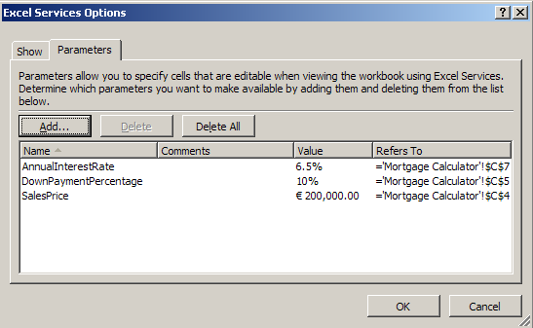
Parameters
Allows the creator of the document to determine what cells can be edited by the user viewing the workbook in Excel services.

Slide 9
Excel Features will not load
Code
Information Rights Management (IRM) protection.
ActiveX controls.
Embedded smart tags.
PivotTables report with multiple consolidation ranges.
External references (workbooks that contain links to other workbooks).
Workbooks saved in formula view.
XML expansion packs.
XML maps.
Data validation.
Query tables, SharePoint lists, Web queries, and text queries.
Workbooks that reference add-ins.
Workbooks that use the RTD() function.
Workbooks that use workbook and worksheet protection.
Embedded pictures or clip art.
Cell and sheet background pictures.
AutoShapes and WordArt.
Ink annotations.
Organization charts and diagrams.
DDE links.

Slide 10
Workbooks that will not render
Split and frozen panes
Headers and footers
Page layout view
Cell patterns
Zoom
Microsoft SQL Server Analysis Services' member properties in ScreenTips
Some cell formatting, such as diagonal borders and border types not supported by HTML
Notes:
List taken from http://msdn2.microsoft.com/en-us/library/ms496823.aspx, for more information.

Slide 11
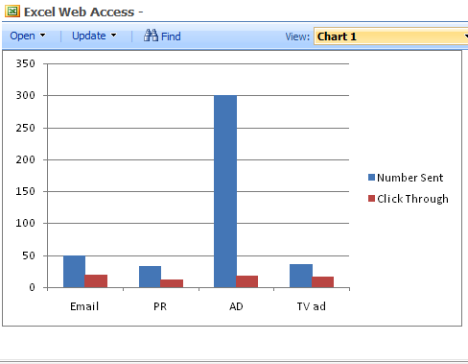
Excel Web Access Web Part
Web Part to view Excel workbooks on a page
Entire Workbook
Specified range of cells
Named Item

Slide 12
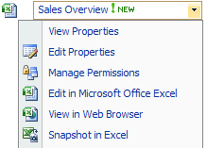
Snap Shot
Allows for the limited viewing of a workbook from Excel Services
Items such as private information, formulas, and hidden data are removed

Slide 13
Summary
Excel Services Architecture
Configuring Trusted Locations
Publishing spreadsheets that render as HTML
Using Data Connections

